Slide 1


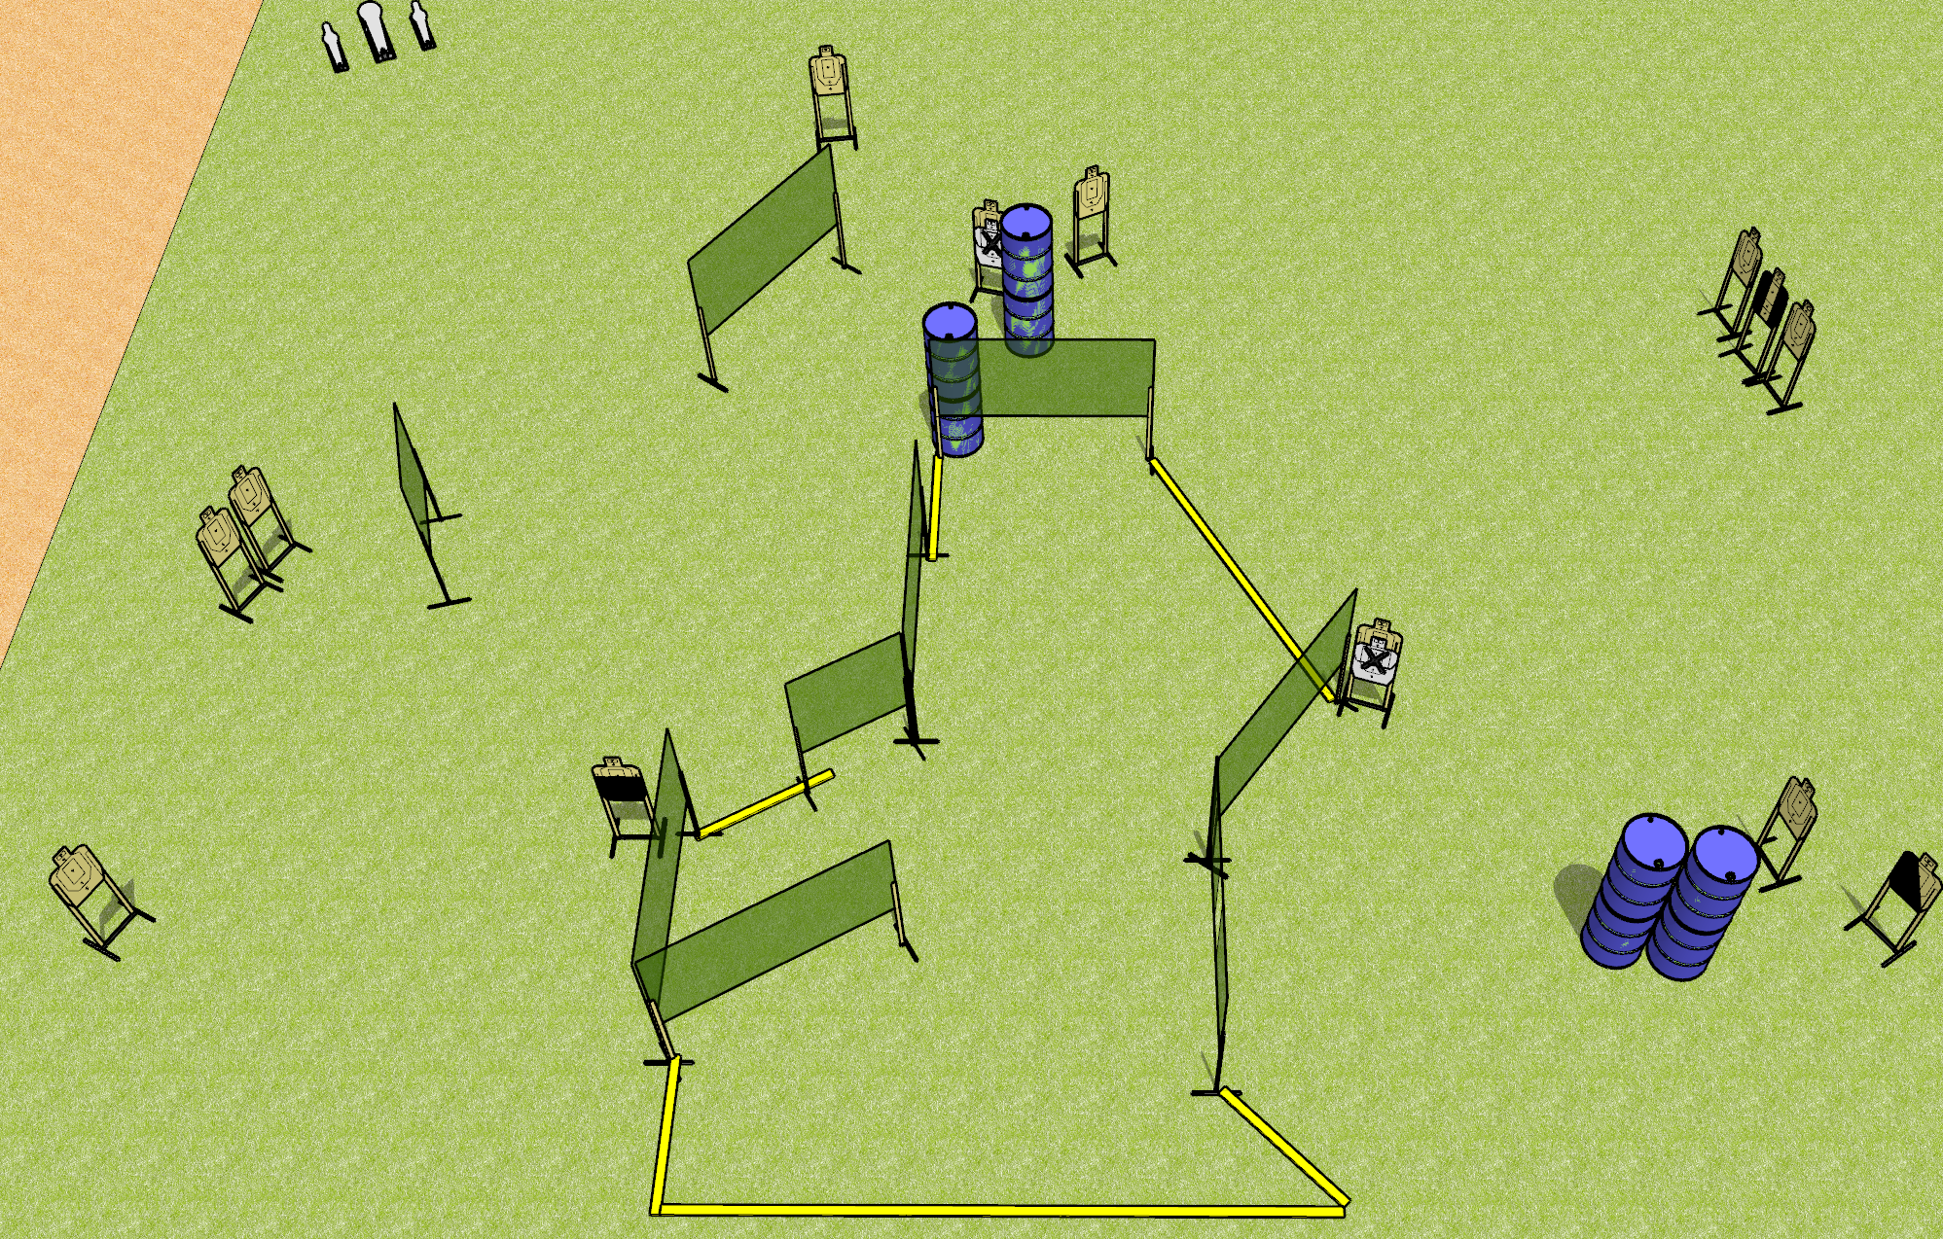
 | Dothan Gun Club – USPSA Match Get Back Course Designer : Drew Coleman
Round Count 29 rounds 13 USPSA 1 colt, 2 minis
Equipment List 18 wall feet 4 medium fault lines 1 tux, 1 50%, 1 left diag 12 paper (2NS + 10 open)
XX

Slide 2
Get Back
Written Stage Briefing
Get Back is a 29 round, 145 point, Comstock course of fire. There are 13 USPSA targets and 3 steel. The best 2 hits on cardboard will score, and steel must fall to score.
Handgun start position is both hands touching marks. Handgun is loaded and holstered.
PCC start position is muzzle touching either mark, stock on belt. Loaded carbine is held with both hands, safety on.
On the audible start signal, engage targets as they become available from within the shooting area.

